Slide 1


Generative AI and Business

Slide 2
How to explore the potential of Gen AI for business / jobs
List all tasks associated with a job
For each task determine the potential of Gen AI

Slide 3
Computer programmer
Task | GenAI Potential
Code generation (from natural language prompts) | High
Code completion and autocompletion | High
Code documentation generation | High
Bug detection and fixing | High
Code refactoring and optimization | Medium
Unit test generation | High
Integration testing and system testing | Medium
API design and schema generation | Medium
Writing configuration or deployment scripts (e.g., Docker, CI/CD) | Medium
Legacy code understanding and migration | Medium
Algorithm design and complexity optimization | Low
Security auditing and vulnerability detection | Medium
Debugging complex runtime issues | Medium
Code review and style checking | High
Software architecture design | Low
Requirement analysis and system specification | Medium
Learning and teaching programming concepts | High
Generating technical documentation or READMEs | High
Data structure selection and performance tuning | Low
Cross-language code translation (e.g., Python → Java) | High

Slide 4
Lawyer
Task | GenAI Potential
Drafting contracts and legal documents | High
Reviewing and summarizing contracts | High
Legal research and case law retrieval | High
Generating legal memos or briefs (first draft) | High
Due diligence document review | High
Compliance checking and monitoring | Medium
Risk assessment and legal opinion formation | Medium
Negotiation strategy and client counseling | Low
Predicting case outcomes | Medium
Discovery and e-discovery document analysis | High
Legal translation and multilingual document review | High
Drafting court pleadings and motions | Medium
Statutory interpretation and complex legal reasoning | Low
Contract clause comparison and version tracking | High
Summarizing legislation or regulatory updates | High
Intellectual property search and filing assistance | Medium
Drafting privacy policies and terms of service | High
Ethical and professional judgment decisions | Low
Client communication and correspondence drafting | Medium
Internal knowledge management (precedents, templates) | High

Slide 5
Helping customers build websites
Task | GenAI Potential
Website design (layout, color scheme, theme generation) | High
Generating website content (text, images, copywriting) | High
Title generation for a given content or article | High
Creating logos and brand identity elements | High
Writing HTML, CSS, and JavaScript code | High
Building website structure and navigation | High
SEO optimization (keywords, meta descriptions) | High
Creating marketing materials and landing pages | High
Multilingual website generation | High

Slide 6
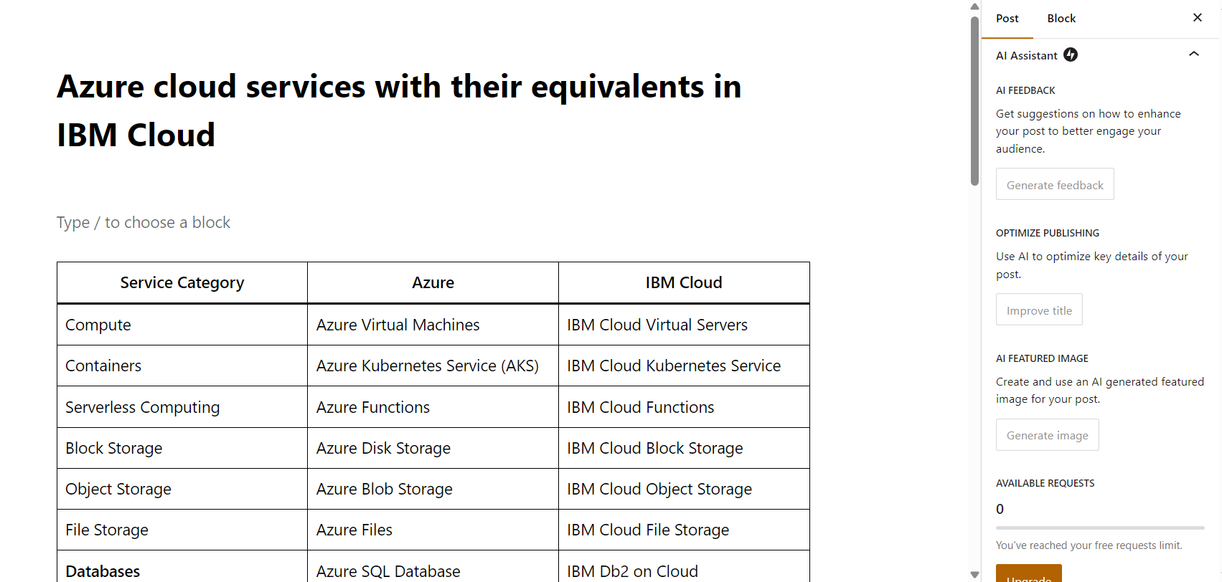
Wordpress AI Assitant

Slide 7
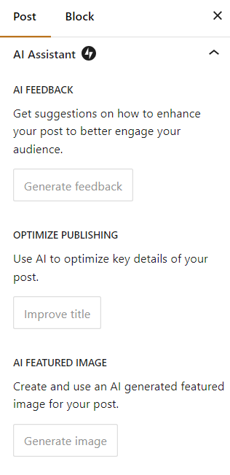
Wordpress AI Assitant

Slide 8
Landscraper
Task | GenAI Potential
Planting flowers, trees, and shrubs | Low
Watering and irrigation management | Low
Pruning, trimming, and shaping plants | Low
Mowing lawns and turf maintenance | Low
Fertilizing and soil treatment | Low
Pest and disease treatment (manual application) | Low
Harvesting or seasonal plant care | Low
Transporting and buying plants/materials | Low
Operating landscaping machinery (e.g., lawnmowers, excavators) | Low
Installing hardscape features (paths, patios, fences) | Low
Mulching, composting, and garden bed preparation | Low
Seasonal cleanup (leaves, debris) | Low
Monitoring plant health using AI-assisted image analysis | Medium
Planning irrigation and fertilization schedules | Medium
Sourcing plants and materials online | Medium

Slide 9
Resilience Planner (focused on critical infrastructures)
Task | GenAI Potential | Notes / Examples
Risk assessment and scenario analysis | High | GenAI can analyze historical data, simulate threats, and generate potential impact scenarios.
Infrastructure vulnerability mapping | High | Can process sensor, GIS, and maintenance data to identify weak points.
Developing resilience strategies | Medium | Can suggest strategies based on best practices, but final decisions require expert judgment.
Emergency response planning | Medium | Can generate response plans, checklists, and protocols, but human coordination is essential.
Incident simulation and training | High | Can create realistic simulated incidents for staff training and tabletop exercises.
Policy and procedure drafting | High | Can draft SOPs, contingency plans, and guidelines quickly.
Monitoring and analyzing real-time system data | Medium | Can flag anomalies or patterns but requires integration with live systems.
Reporting and documentation | High | Can generate reports, summaries, and dashboards from data automatically.
Collaboration and stakeholder communication | Medium | Can draft emails, presentations, and meeting notes, but human approval is needed.
Post-incident review and lessons learned | High | Can summarize events, extract insights, and suggest improvements.
Regulatory compliance checking | Medium | Can cross-check procedures and reports against legal/regulatory frameworks.
Predictive maintenance planning | Medium | Can help identify likely failure points based on historical data.
Prioritization of resources and investments | Medium | Can suggest optimizations based on risk and impact data.
Scenario-based policy simulation | High | Can run multiple “what-if” analyses using AI models to anticipate outcomes.
Integration of new technologies into infrastructure | Low | GenAI can provide suggestions, but detailed technical evaluation is required.

Slide 10
Cybersecurity Engineer (focused on critical infrastructures)
Task | GenAI Potential | Notes / Examples
Threat intelligence gathering | High | GenAI can process large volumes of threat reports, dark web info, and news to identify emerging threats.
Vulnerability scanning and assessment | High | Can analyze scan results, prioritize risks, and suggest mitigations.
Security monitoring (SIEM analysis) | High | Can help detect anomalies and generate alerts from logs and network data.
Incident response planning | Medium | Can draft playbooks and response strategies, but real-time coordination requires human oversight.
Penetration testing assistance | Medium | Can suggest attack vectors, generate scripts, or interpret results, but cannot replace hands-on testing.
Firewall, IDS/IPS, and network configuration | Medium | Can suggest configuration rules and optimizations, but implementation requires human action.
Malware analysis | Medium | Can assist in code analysis and behavioral detection, but complex threats need expert review.
Security policy drafting | High | Can generate policies, compliance documentation, and guidelines efficiently.
User awareness training content | High | Can generate training modules, phishing simulations, and educational material.
Risk assessment and reporting | High | Can automate report generation and summarize risk levels for management.
Patch management planning | Medium | Can prioritize patching based on vulnerability data and threat intelligence.
Log analysis and anomaly detection | High | Can parse logs, detect patterns, and highlight suspicious activity.
Compliance and regulatory checking | Medium | Can cross-reference internal policies with regulations and generate compliance reports.
Forensic investigation support | Medium | Can assist in analyzing logs, tracing attack paths, and documenting findings.
Threat modeling and architecture review | Medium | Can suggest potential threat vectors, but architecture decisions need human judgment.

Slide 11
New workflows and new Opportunities

Slide 12
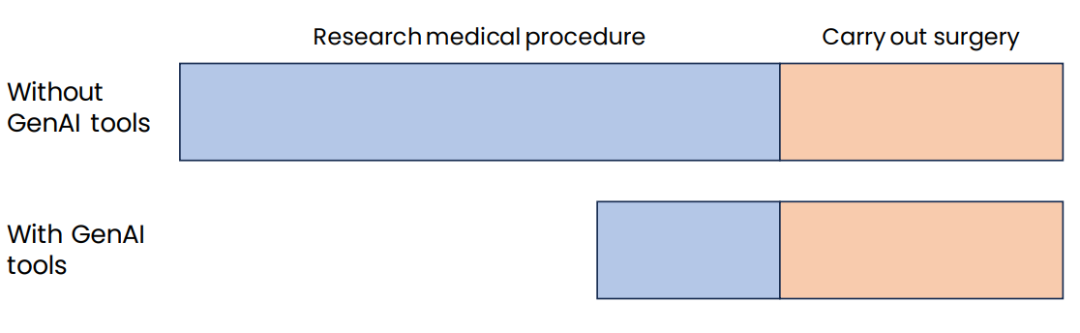
Example 1: Surgeon

Slide 13
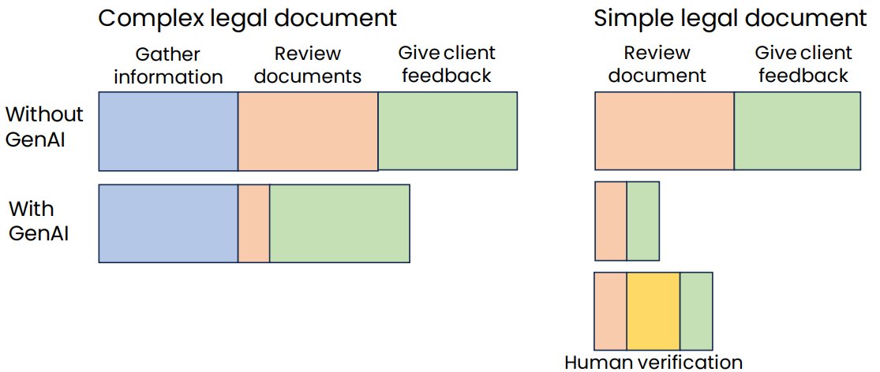
Example 2: Legal documentation review

Slide 14
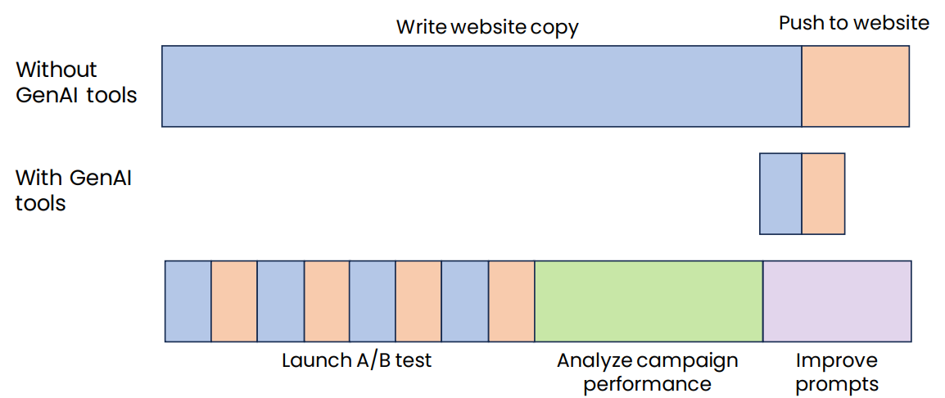
Example 3: Marketing automation

Slide 15


Q&A

